Slide 1
First steps:
Prepare reference databases and trees
TRAITS project meeting: 7-10 September 2021 – CNB, Madrid

Slide 2
Install software:
Install Miniconda:
https://docs.conda.io/projects/conda/en/latest/user-guide/install/linux.html
configure channels
$ conda config --add channels defaults
$ conda config --add channels bioconda
$ conda config --add channels conda-forge
create a new environment and install programs:
$ conda create -n traits
$ conda install python=3.9.6
$ conda install -c conda-forge biopython
$ conda install -c bioconda seqkit prodigal hmmer muscl iqtree epa-ng gappa
Install Papara
https://cme.h-its.org/exelixis/web/software/papara/index.html

Slide 3
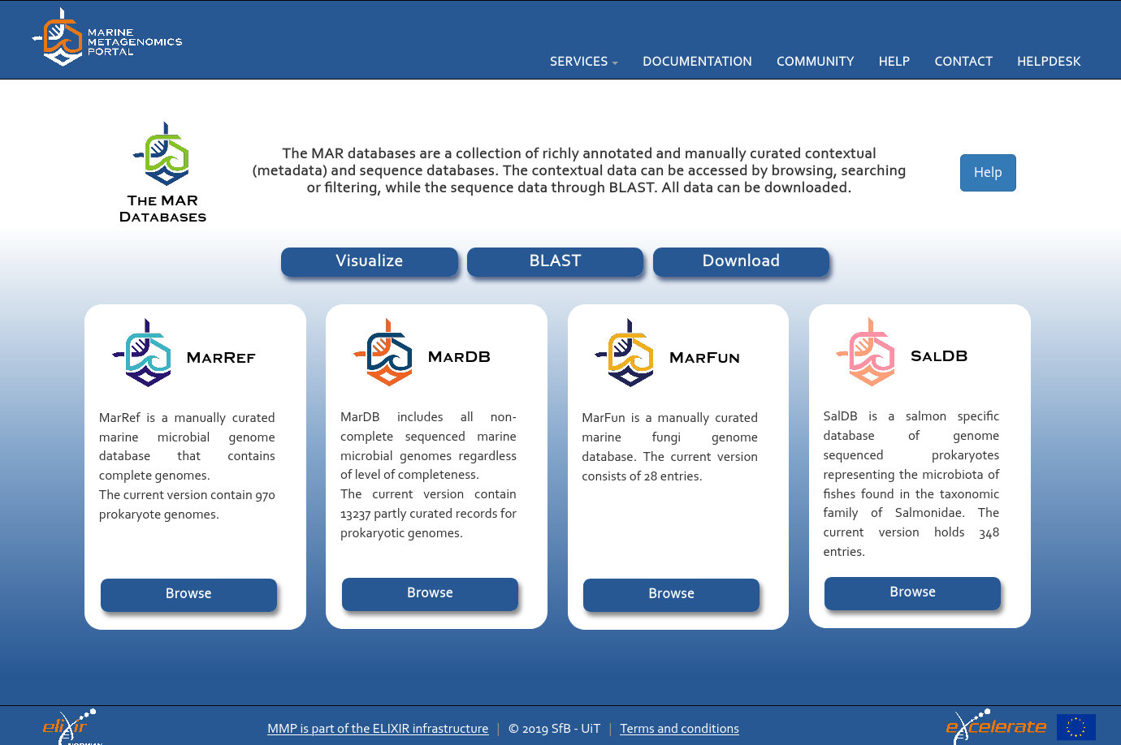
Download MAR databases:
https://mmp.sfb.uit.no/databases/

Slide 4
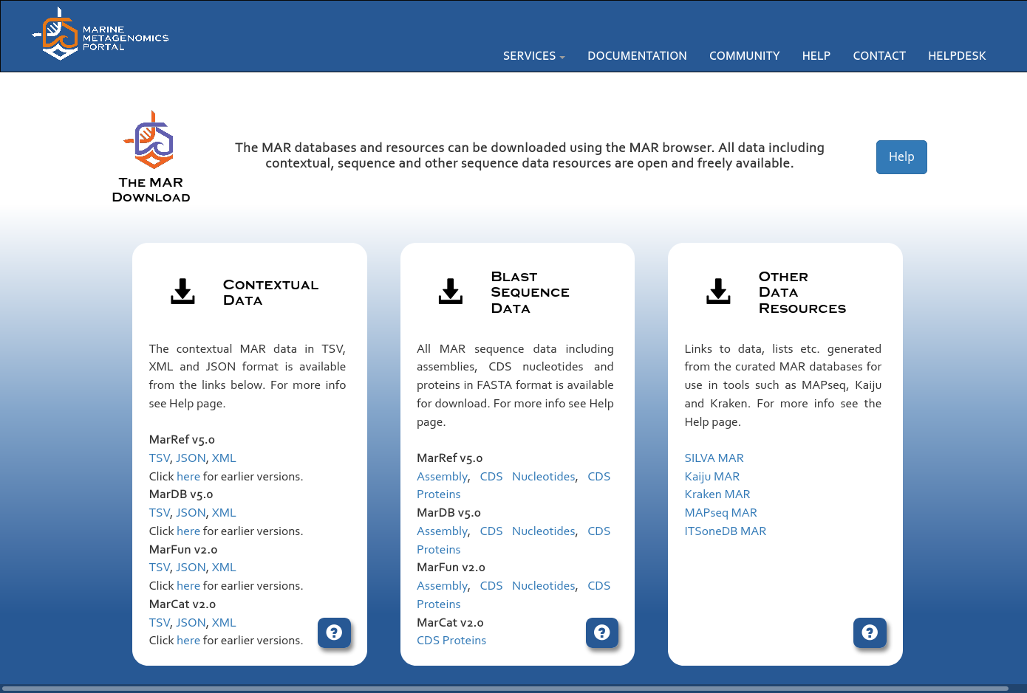
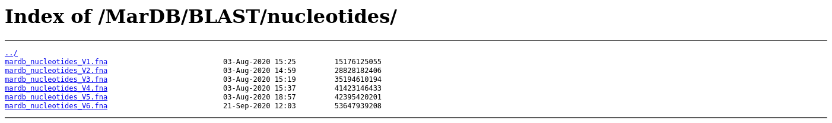
Download DNA versions
- Click on CDS Nucleotides
- Next page: look for most recent version and copy link

Slide 5
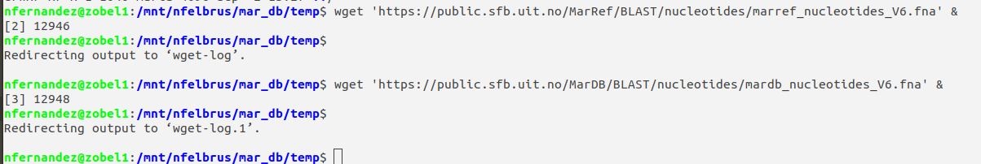
Back to your terminal:
$ wget 'https://public.sfb.uit.no/MarDB/BLAST/nucleotides/mardb_nucleotides_V6.fna' &
$ wget 'https://public.sfb.uit.no/MarRef/BLAST/nucleotides/marref_nucleotides_V6.fna' &
Other databases:
Paoli’s dataset contains MAR databases – discuss
Use of JGI-GOLD

Slide 6
Overview
MAR DBs
nucleotides
1.- Remove duplicates by name (seqkit)
2. - change names (biopython)
3. - Translate to aa (Prodigal / seqkit)
nosZ hits reference MSA
fasta / phylip
Phylogenetic placement of environmental sequences
nosZ hits reference sequences
Alignment
MUSCLE
Filter hits (seqkit)
Build tree (iqTREE)
Tree with all sequences (analyze with gappa)
MAR DBs
proteins
gawk
MAR DB aa
Clean IDs
nosZ Reference Tree
hmmrsearch
HMM models
2 TIGRfams
List IDs
Short sequences placement (EPA-ng)
Align sequences with phylogenetic information (PaPaRa)
Aligned nosZ fungene
nosZ
hits table
biophyton
Remove duplicates + uppercase
nosZ fungene sequences
Fungene nosZ sequence collections

Slide 7
Overview
MAR DBs
nucleotides
1.- Remove duplicates by name (seqkit)
2. - change names (biopython)
3. - Translate to aa (Prodigal / seqkit)
nosZ hits reference MSA
fasta / phylip
Phylogenetic placement of environmental sequences
nosZ hits reference sequences
Alignment
MUSCLE
Filter hits (seqkit)
Build tree (iqTREE)
Tree with all sequences (analyze with gappa)
MAR DBs
proteins
gawk
MAR DB aa
Clean IDs
nosZ Reference Tree
hmmrsearch
HMM models
2 TIGRfams
List IDs
Short sequences placement (EPA-ng)
Align sequences with phylogenetic information (PaPaRa)
Aligned nosZ fungene
nosZ
hits table
biophyton
Remove duplicates + uppercase
nosZ fungene sequences
Fungene nosZ sequence collections

Slide 8
Prepare databases:
Databases seem to contain duplicates – removing them
$ conda activate traits
Do not run (MarRef – no duplicates):
$ cat marref_nucleotides_V6.fna | seqkit rmdup -n -o marrefnoDup_nucleotides.fna -d duplicates_marref.fna -D duplicates_marref_info.txt
[INFO] 0 duplicated records removed
MarDB - seqkit tool:
n: duplicates identification by name (not by sequence)
d: fasta with duplicated sequences
D: text file with information
$ cat mardb_nucleotides_V6.fna | seqkit rmdup -n -o mardbnoDup_nucleotides.fna -d duplicates_mardb.fna -D duplicates_mardb_info.txt 1>log_rmdup.txt 2>&1 &
$ cat log_rmdup.txt
[INFO] 12890 duplicated records removed
$ less duplicates_mardb_info.fna

Slide 9
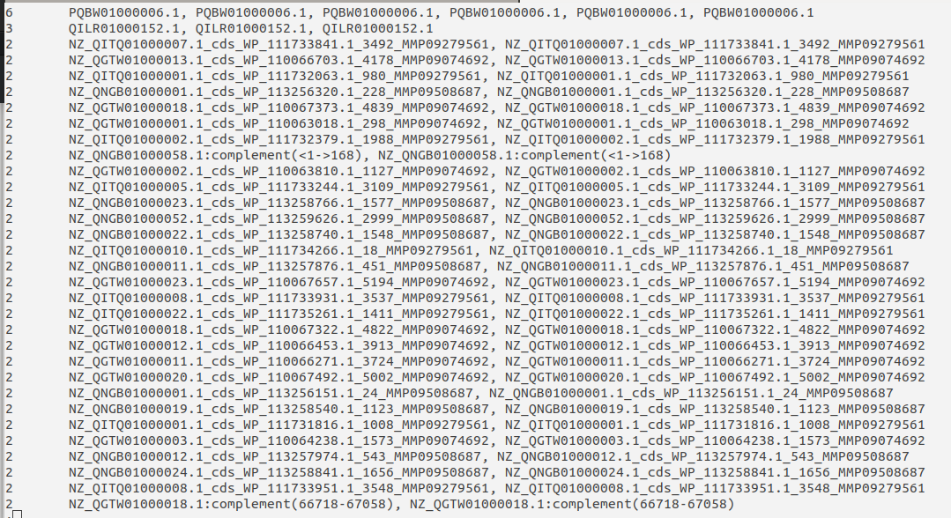

Slide 10
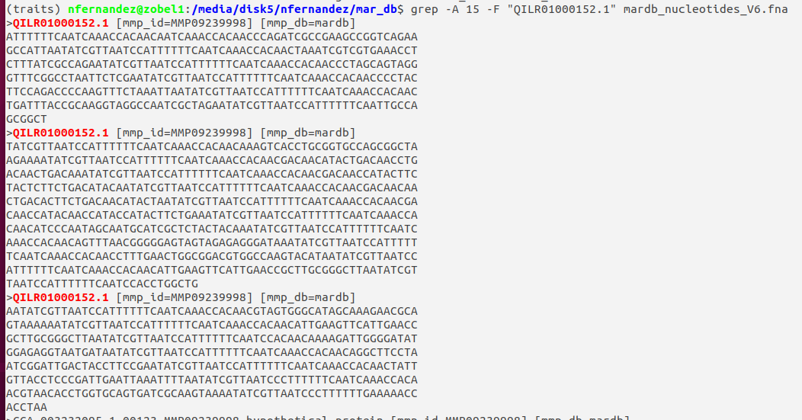

Slide 11
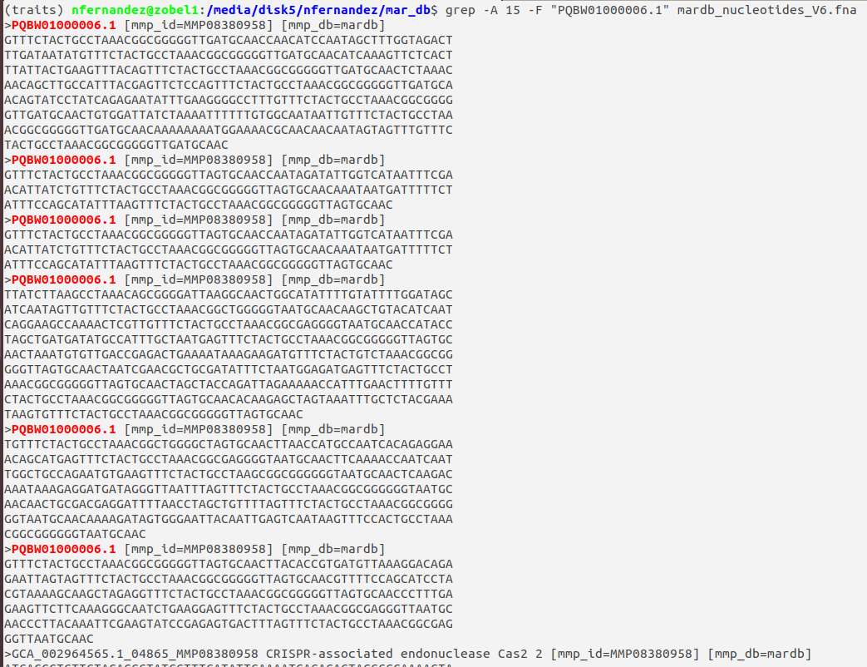

Slide 12
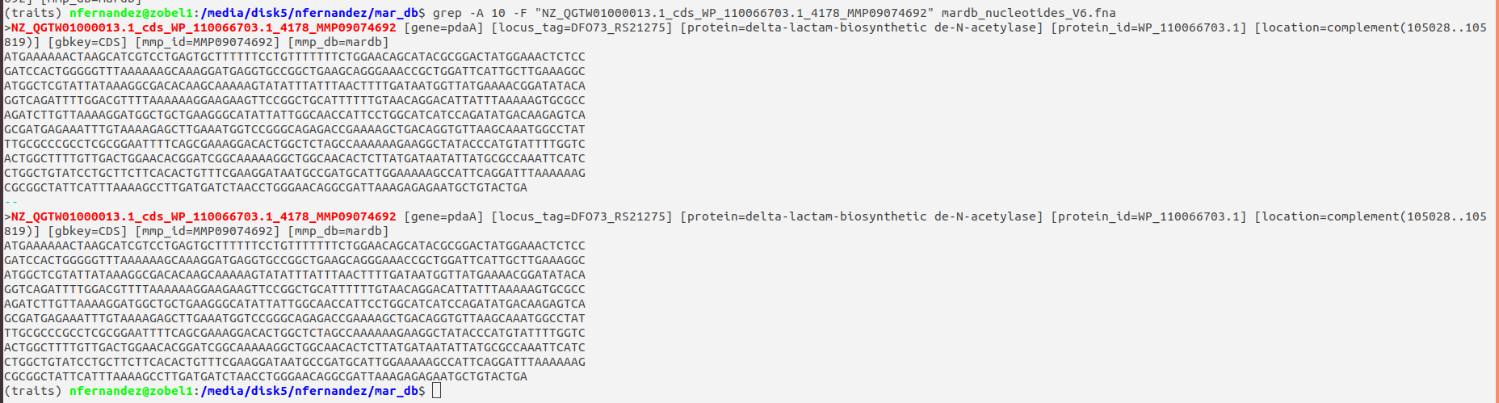
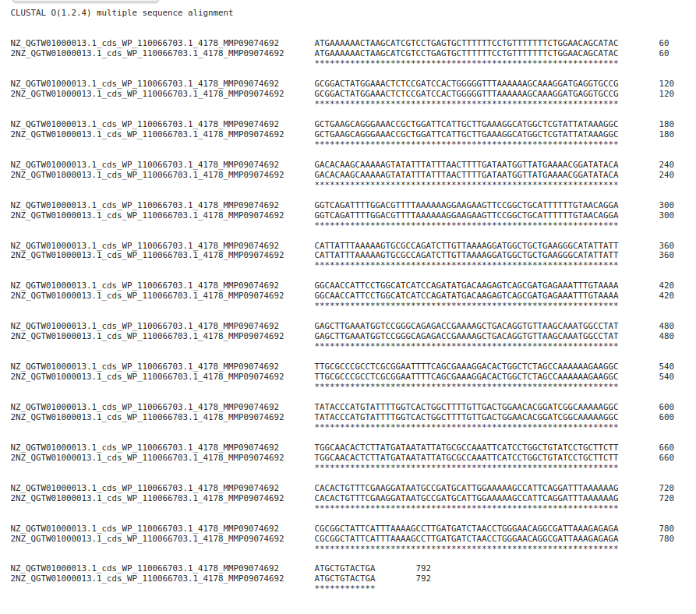
Almost all sequences are real duplicates

Slide 13
Join MarRef and MarDB without nucleotides in a single fasta:
$ cat marref_nucleotides_V6.fna mardbnoDup_nucleotides.fna > mar_nucleotides.fna &
Rename sequences to avoid long names:
Custom python script rename_mar_seqs.py
Copy to folder where sequences are, check permissions, and run it:
$ chmod u+x rename_mar_seqs.py
$ python rename_mar_seqs.py 1>log_rename.txt 2>&1 &
from Bio.SeqIO.FastaIO import SimpleFastaParser
newseqs = {}
equivalent = {}
# parse fasta file with the low-level SimpleFastaParser, reads it as a tuple
with open("marref_sample10pc.fna") as sequences:
for k, seq in enumerate(SimpleFastaParser(sequences)):
newseqs[k]=seq[1]
equivalent[k]=seq[0]
ofile = open("marsample.fna", "w")
for i in newseqs.keys():
ofile.write(">{}\n{}\n".format(i, newseqs[i]))
ofile.close()
ofile = open("marsample_names_equivalence.txt", "w")
for i in equivalent.keys():
ofile.write("{}\t{}\n".format(i, equivalent[i]))
ofile.close()

Slide 14
Translate from DNA to proteins:
With gene prediction - using Prodigal (full database takes ~3 days):
$ prodigal -i mar_renamed_nucleotides.fna -o mar_gene_coords.gbk -a mar_proteintrans.faa -p meta 2>log_prodigal.err &
Small dataset as example for this meeting - 10% of MarRef database:
$ prodigal -i marsample.fna -o marsample_gene_coords.gbk -a marsample_proteintrans.faa -p meta 2>log_sample_prod.txt &
Without gene prediction – using seqkit:
-T 11: genetic code to use: 11 is The Bacterial, Archaeal and Plant Plastid Code
--trim: remove the stop codón (just done because MUSCLE complains)
$ seqkit translate -T 11 --trim mar_renamed_nucleotides.fna > mar_proteintrans_v2.faa 2>log_seqkit.txt &

Slide 15
Overview
MAR DBs
nucleotides
1.- Remove duplicates by name (seqkit)
2. - change names (biopython)
3. - Translate to aa (Prodigal / seqkit)
nosZ hits reference MSA
fasta / phylip
Phylogenetic placement of environmental sequences
nosZ hits reference sequences
Alignment
MUSCLE
Filter hits (seqkit)
Build tree (iqTREE)
Tree with all sequences (analyze with gappa)
MAR DBs
proteins
gawk
MAR DB aa
Clean IDs
nosZ Reference Tree
hmmrsearch
HMM models
2 TIGRfams
List IDs
Short sequences placement (EPA-ng)
Align sequences with phylogenetic information (PaPaRa)
Aligned nosZ fungene
nosZ
hits table
biophyton
Remove duplicates + uppercase
nosZ fungene sequences
Fungene nosZ sequence collections

Slide 16
Clean fasta headers of Prodigal output
$ gawk 'BEGUIN{FS="#"}{if ($1 ~ /^>/) print $1; else print $0}' marsample_proteintrans.faa |\
sed 's/_1//g' >marsample_proteintrans_clean.faa
$ gawk 'BEGUIN{FS="#"}{if ($1 ~ /^>/) print $1; else print $0}' mar_proteintrans.faa |\
sed 's/_1//g' > mar_proteintrans_clean.faa 2>err_gawk.txt &

Slide 17
Overview
MAR DBs
nucleotides
1.- Remove duplicates by name (seqkit)
2. - change names (biopython)
3. - Translate to aa (Prodigal / seqkit)
nosZ hits reference MSA
fasta / phylip
Phylogenetic placement of environmental sequences
nosZ hits reference sequences
Alignment
MUSCLE
Filter hits (seqkit)
Build tree (iqTREE)
Tree with all sequences (analyze with gappa)
MAR DBs
proteins
gawk
MAR DB aa
Clean IDs
nosZ Reference Tree
hmmrsearch
HMM models
2 TIGRfams
List IDs
Short sequences placement (EPA-ng)
Align sequences with phylogenetic information (PaPaRa)
Aligned nosZ fungene
nosZ
hits table
biophyton
Remove duplicates + uppercase
nosZ fungene sequences
Fungene nosZ sequence collections

Slide 18
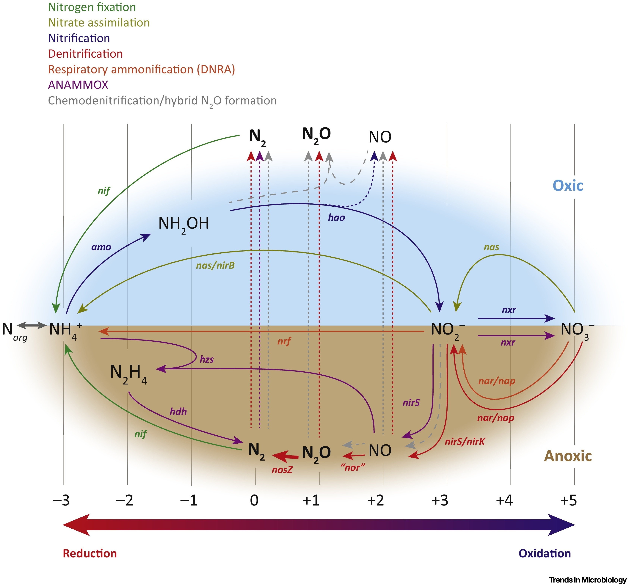
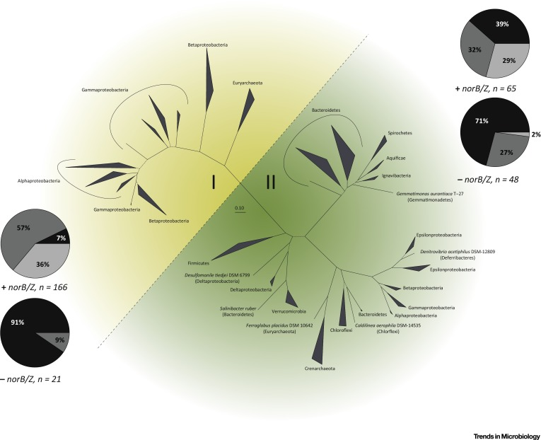
Search for a specific protein – Nitrous oxide reductase (NosZ) – N₂O reduction trait
- high diversity (12 phyla)
- mostly vertical inheritance
- Two clades (I and II). Differences:
- associated N₂O membrane translocation pathway
- nos gene cluster organization
- frequencies of co-ocurrence with other denitrification or respiratory ammonificatoin pathway genes
N-cycle
Hallin et al. 2018

Slide 19
Build a reliable nosZ database and reference tree: search nosZ in the full database
Hiden Markov Models (HMMs) – look for them:
NCBI conserved domain database: https://www.ncbi.nlm.nih.gov/cdd/
Fungene database: http://fungene.cme.msu.edu/
Two TIGRfams:
type I and II
Protocol for building our own HMMs??

Slide 21
HMM – copy this link
Multiple Sequence Alignment of seed sequences
$ wget https://ftp.ncbi.nlm.nih.gov/hmm/current/hmm_PGAP.HMM/TIGR04246.1.HMM

Slide 22
HMMs beginning
$ less TIGR04246.1.HMM
2 HMMs: put them toguether in a single file:
$ cat TIGR04244.1.HMM TIGR04246.1.HMM > TIGRnosZ.HMM

Slide 23
I used the 27 seed sequences to check the diversity used to build those HMMs:
Missing a lot of known diversity – i.e. Archaea
Type I
Type II
Need to discuss a QC protocol for third-part HMMs??

Slide 24
Search nosZ in MAR databases - HMMER:
Command: hmmsearch
--noali: don´t keep alignment
--domtblout: output type – domain hits table (when there is more than 1 domain)
--cut-ga: use HMM gathering threshold as cutoff
--cpu: number of threads
Small dataset:
$ hmmsearch --noali --domtblout marsample_nosZ_tigrfam.hmm --cut_ga --cpu 15 TIGRnosZ.HMM marsample_proteintrans_clean.faa > /dev/null 2>hmmerrlog.txt &
Full database:
$ hmmsearch --noali --domtblout /mnt/nfelbrus2/mar_db/mar_nosZ_tigrfam.hmm --cut_ga --cpu 15 /media/disk5/nfernandez/nosZ/TIGRnosZ/TIGRnosZ.HMM /mnt/nfelbrus2/mar_db/mar_proteintrans_clean.faa > /dev/null 2>/mnt/nfelbrus2/mar_db/hmmerrlog.txt &
$ wc -l mar_nosZ_tigrfam.hmm
1482 mar_nosZ_tigrfam.hmm. (-13 lines from file header and end): 1469 nosZ sequences

Slide 25
HMMER output table:
Hits: potential NosZ sequences IDs

Slide 26
Overview
MAR DBs
nucleotides
1.- Remove duplicates by name (seqkit)
2. - change names (biopython)
3. - Translate to aa (Prodigal / seqkit)
nosZ hits reference MSA
fasta / phylip
Phylogenetic placement of environmental sequences
nosZ hits reference sequences
Alignment
MUSCLE
Filter hits (seqkit)
Build tree (iqTREE)
Tree with all sequences (analyze with gappa)
MAR DBs
proteins
gawk
MAR DB aa
Clean IDs
nosZ Reference Tree
hmmrsearch
HMM models
2 TIGRfams
List IDs
Short sequences placement (EPA-ng)
Align sequences with phylogenetic information (PaPaRa)
Aligned nosZ fungene
nosZ
hits table
biophyton
Remove duplicates + uppercase
nosZ fungene sequences
Fungene nosZ sequence collections

Slide 27
Retrieve found nosZ sequences.
Get list of IDs into a text file:
$ python parse_marsampleHMM.py
$ less hits_marsample.txt
$ python parse_marNosZhmm.py
$ wc -l hits_mar_nosZ.txt
1469 hits_mar_nosZ.txt
Output:
from Bio import SearchIO
import csv
# Read the output table of database search with TIGRFAMs HMMs for nosZ
hmm_qresult = SearchIO.parse('marsample_nosZ_tigrfam.hmm', 'hmmsearch3-domtab')
# Filter table to make a list of hits IDs
hit_ids = []
for qresult in hmm_qresult:
for i in range(len(qresult)):
hit_ids.append(qresult[i].id)
# Write list to a text file
file = open('hits_nosZ_marsample.txt', 'w')
for index in range(len(hit_ids)):
file.write(str(hit_ids[index]) + "\n")
file.close()

Slide 28
Retrieve found nosZ sequences.
Create fasta file with MAR nosZ sequences
Filter database to keep only nosZ sequences by their ID:
$ seqkit grep -f hits_nosZ_marsample.txt marsample_proteintrans_clean.faa -o hits_nosZ_marsample.faa
$ seqkit grep -f hits_mar_nosZ.txt mar_proteintrans_clean.faa -o mar_nosZ.faa &

Slide 29
Overview
MAR DBs
nucleotides
1.- Remove duplicates by name (seqkit)
2. - change names (biopython)
3. - Translate to aa (Prodigal / seqkit)
nosZ hits reference MSA
fasta / phylip
Phylogenetic placement of environmental sequences
nosZ hits reference sequences
Alignment
MUSCLE
Filter hits (seqkit)
Build tree (iqTREE)
Tree with all sequences (analyze with gappa)
MAR DBs
proteins
gawk
MAR DB aa
Clean IDs
nosZ Reference Tree
hmmrsearch
HMM models
2 TIGRfams
List IDs
Short sequences placement (EPA-ng)
Align sequences with phylogenetic information (PaPaRa)
Aligned nosZ fungene
nosZ
hits table
biophyton
Remove duplicates + uppercase
nosZ fungene sequences
Fungene nosZ sequence collections

Slide 30
Multiple sequence alignment of MAR nosZ sequences – MUSCLE – small dataset
$ mkdir alignments
$ muscle -in hits_nosZ_marsample.faa -phyiout alignments/hits_nosZ_aligned.phy -fastaout alignments/hits_nosZ_aligned.faa
Save output in two formats: fasta and phylip (we might need only one)

Slide 31
Overview
MAR DBs
nucleotides
1.- Remove duplicates by name (seqkit)
2. - change names (biopython)
3. - Translate to aa (Prodigal / seqkit)
nosZ hits reference MSA
fasta / phylip
Phylogenetic placement of environmental sequences
nosZ hits reference sequences
Alignment
MUSCLE
Filter hits (seqkit)
Build tree (iqTREE)
Tree with all sequences (analyze with gappa)
MAR DBs
proteins
gawk
MAR DB aa
Clean IDs
nosZ Reference Tree
hmmrsearch
HMM models
2 TIGRfams
List IDs
Short sequences placement (EPA-ng)
Align sequences with phylogenetic information (PaPaRa)
Aligned nosZ fungene
nosZ
hits table
biophyton
Remove duplicates + uppercase
nosZ fungene sequences
Fungene nosZ sequence collections

Slide 32
Build a tree of nosZ MAR sequences – iqTREE – small dataset
Two main steps:
Find the best substitution model for the dataset (user can specify it)
Build the ML tree
$ iqtree -nt AUTO -ntmax 15 -s alignments/hits_nosZ_aligned.faa
Options:
-nt AUTO : number of threads
-ntmax 15: If AUTO, max number of threads
-s: aligned sequences to build the tree
-pre: prefix for output files (not used here)
-m: model (not used here)

Slide 33
MSA of MAR nosZ sequences and tree - full database
Align with MUSCLE
$ mkdir alignments
$ muscle -in mar_nosZ.faa -phyiout alignments/mar_nosZ_aligned.phy -fastaout alignments/mar_nosZ_aligned.faa 1>muscle_log.txt 2>&1 &
Tree with iqTREE
$ iqtree -nt AUTO -ntmax 18 -s alignments/mar_nosZ_aligned.phy 1>log_iqtree.txt 2>&1 &

Slide 34
Overview
MAR DBs
nucleotides
1.- Remove duplicates by name (seqkit)
2. - change names (biopython)
3. - Translate to aa (Prodigal / seqkit)
nosZ hits reference MSA
fasta / phylip
Phylogenetic placement of environmental sequences
nosZ hits reference sequences
Alignment
MUSCLE
Filter hits (seqkit)
Build tree (iqTREE)
Tree with all sequences (analyze with gappa)
MAR DBs
proteins
gawk
MAR DB aa
Clean IDs
nosZ Reference Tree
hmmrsearch
HMM models
2 TIGRfams
List IDs
Short sequences placement (EPA-ng)
Align sequences with phylogenetic information (PaPaRa)
Aligned nosZ fungene
nosZ
hits table
biophyton
Remove duplicates + uppercase
nosZ fungene sequences
Fungene nosZ sequence collections

Slide 35
Retrieve and prepare environmental sequences
I have cheated…protocol not developed yet.
My turnaround:
http://fungene.cme.msu.edu/

Slide 36
Overview
MAR DBs
nucleotides
1.- Remove duplicates by name (seqkit)
2. - change names (biopython)
3. - Translate to aa (Prodigal / seqkit)
nosZ hits reference MSA
fasta / phylip
Phylogenetic placement of environmental sequences
nosZ hits reference sequences
Alignment
MUSCLE
Filter hits (seqkit)
Build tree (iqTREE)
Tree with all sequences (analyze with gappa)
MAR DBs
proteins
gawk
MAR DB aa
Clean IDs
nosZ Reference Tree
hmmrsearch
HMM models
2 TIGRfams
List IDs
Short sequences placement (EPA-ng)
Align sequences with phylogenetic information (PaPaRa)
Aligned nosZ fungene
nosZ
hits table
biophyton
Remove duplicates + uppercase
nosZ fungene sequences
Fungene nosZ sequence collections

Slide 37
Mock environmental nosZ sequences
I have downloaded the three nosZ datasets available, put them together and removed duplicates:
$ cat fungene_nosZ.faa | seqkit rmdup -n -o fungene_nosZ_noDup.faa -d duplicated_fungene_nosZ.faa -D duplicated_fungene_nosZ_detail.txt
[INFO] 12926 duplicated records removed
Avoid long names. Remove everything but the nucleotide GI that is the first field
$ gawk 'BEGIN{FS=" "}{if ($1 ~ /^>/) print $1; else print $0 }' fungene_nosZ_noDup.faa > fungeneTest.faa
$ wc -l fungeneTest.faa
89856 fungeneTest.faa
Prepare a small subsample of Fungene sequences.
Notice that fungene sequences are lowercase, but mardbs are in uppercase. Fix it with seqkit
$ head -n 55 fungeneTest.faa | seqkit seq -u > query.faa

Slide 38
Phylogenetic placement of environmental sequences
1. – MSA of environmental sequences against reference database (PaPaRa)
PaPaRa requires:
- aligned reference database in phylip format
- reference tree in newick format (default output of iqTREE)
2. - Phylogenetic placement in the reference tree (EPA-ng)
3. - Analysis of results (gappa)

Slide 39
Overview
MAR DBs
nucleotides
1.- Remove duplicates by name (seqkit)
2. - change names (biopython)
3. - Translate to aa (Prodigal / seqkit)
nosZ hits reference MSA
fasta / phylip
Phylogenetic placement of environmental sequences
nosZ hits reference sequences
Alignment
MUSCLE
Filter hits (seqkit)
Build tree (iqTREE)
Tree with all sequences (analyze with gappa)
MAR DBs
proteins
gawk
MAR DB aa
Clean IDs
nosZ Reference Tree
hmmrsearch
HMM models
2 TIGRfams
List IDs
Short sequences placement (EPA-ng)
Align sequences with phylogenetic information (PaPaRa)
Aligned nosZ fungene
nosZ
hits table
biophyton
Remove duplicates + uppercase
nosZ fungene sequences
Fungene nosZ sequence collections

Slide 40
1 – Multiple Sequence Alignment with PaPaRA
PaPaRa options:
-r no additional gaps are included in the original MSA
-a sequences are aminoacid
-t reference tree,
-s reference alignment
-q sequences to align (query sequences),
-j threads
n sufix for output
$ cd alignments/
$ papara -t hits_nosZ_aligned.phy.treefile -a -r -s hits_nosZ_aligned.phy -q ../query.faa -j 4 -n papout 1>log_papara.txt 2>&1 &

Slide 41
1 – Multiple Sequence Alignment with PaPaRA
PaPaRa output, in phylip format:
Reference and query sequences are together in this output, separate them for EPA-ng
$ epa-ng --split hits_nosZ_aligned.phy papara_alignment.papout
(reference alignment)
It produces two files: reference.fasta + query.fasta
to EPA-ng

Slide 42
Overview
MAR DBs
nucleotides
1.- Remove duplicates by name (seqkit)
2. - change names (biopython)
3. - Translate to aa (Prodigal / seqkit)
nosZ hits reference MSA
fasta / phylip
Phylogenetic placement of environmental sequences
nosZ hits reference sequences
Alignment
MUSCLE
Filter hits (seqkit)
Build tree (iqTREE)
Tree with all sequences (analyze with gappa)
MAR DBs
proteins
gawk
MAR DB aa
Clean IDs
nosZ Reference Tree
hmmrsearch
HMM models
2 TIGRfams
List IDs
Short sequences placement (EPA-ng)
Align sequences with phylogenetic information (PaPaRa)
Aligned nosZ fungene
nosZ
hits table
biophyton
Remove duplicates + uppercase
nosZ fungene sequences
Fungene nosZ sequence collections

Slide 43
2. - Phylogenetic placement in the reference tree (EPA-ng)
Need to know the replacement model used in the tree
$ less hits_nosZ_aligned.phy.iqtree

Slide 44
$ mkdir epa-ng-test
$ epa-ng --tree hits_nosZ_aligned.phy.treefile --ref-msa reference.fasta --query query.fasta --out-dir epa-ng-test --model LG+F+R10 > log_epang.txt 2>&1 &
epa-ng options:
--tree: reference tree
--ref-msa: reference multiple sequence alignment, used for tree
--query: sequences to place in the tree, must be aligned against –ref-msa
--out-dir: output directory
--model: substitution model used to build the tree

Slide 45
3. - Analysis of results (gappa)
$ gappa examine graft --jplace-path epa_result.jplace --name-prefix FUNGEN --out-dir gappaout
Type I
Type II

